Slide 1
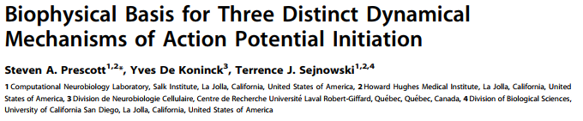
Presented by: Mrittika Dey
Rajat Joshi

Slide 2
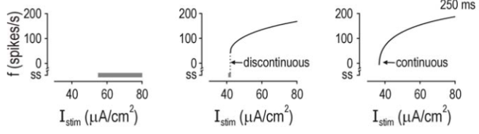
Introduction
Hodgkin classes of excitability (1948), based on the f-I curves of different neurons.
CLASS III CLASS II CLASS I
Morris-Lecar model (1981).

Slide 3



Morris Lecar Model
V’ = fast acting variable
W’ = slow recovery variable
V= membrane potential
Mss, Wss = open state probability functions
M, W = instantaneous open state probability
Tw = time scale for the recovery process

Slide 4
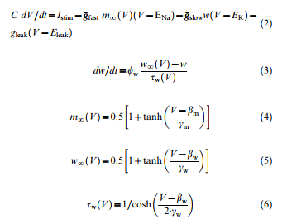
The β_{w} Parameter

Slide 5
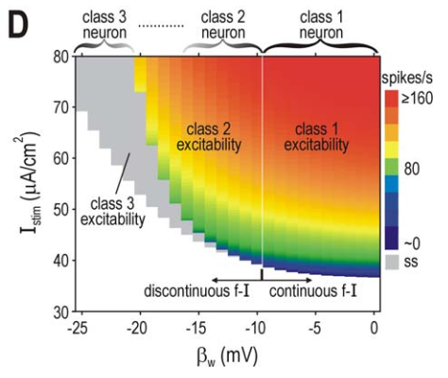
Excitability

Slide 6
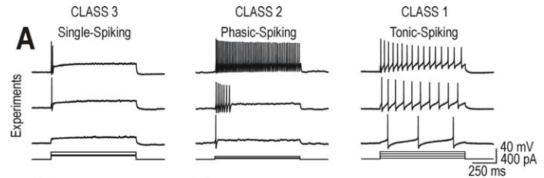
Biophysical Recordings
Lamina I spinal neurons.

Slide 7
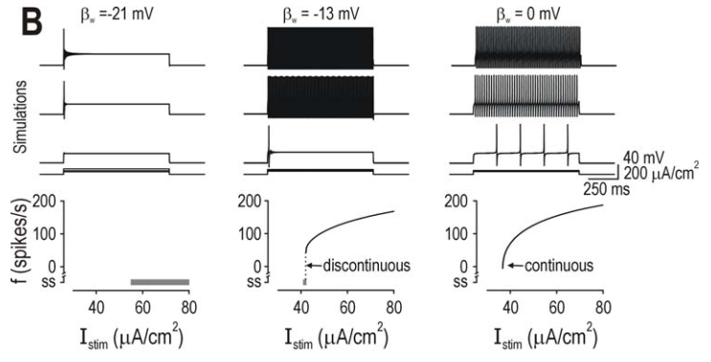
Data from the computational model

Slide 8
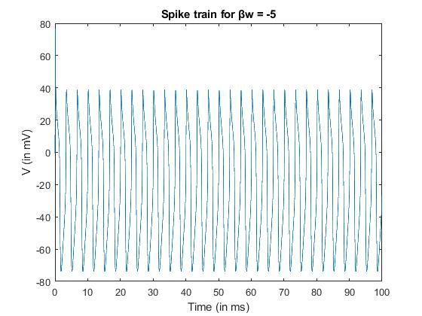
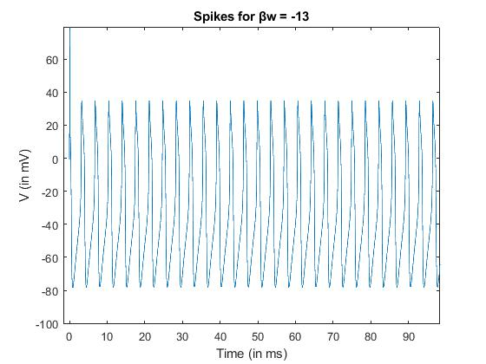
Class I excitability
Class II excitability
Notes:
The total time window was 100ms
There is not much difference in class 1 and class 2 spiking
Mention beta vaues

Slide 9
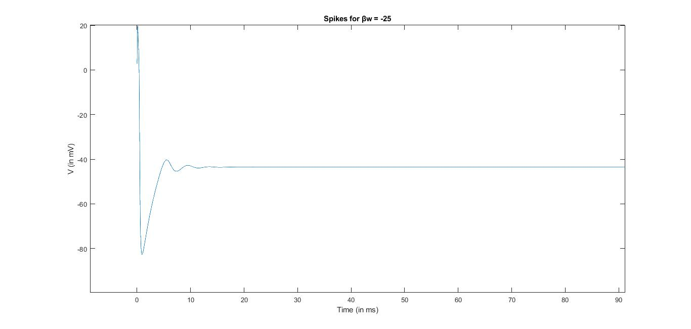
Class III excitability

Slide 10
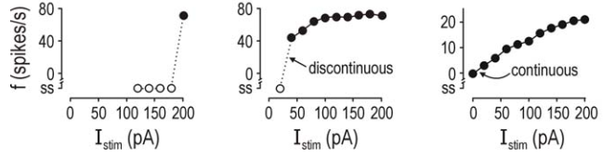
f vs I characteristics of the different classes of excitability

Slide 11
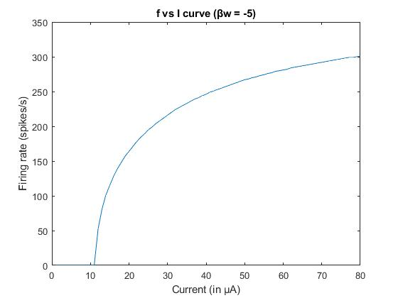
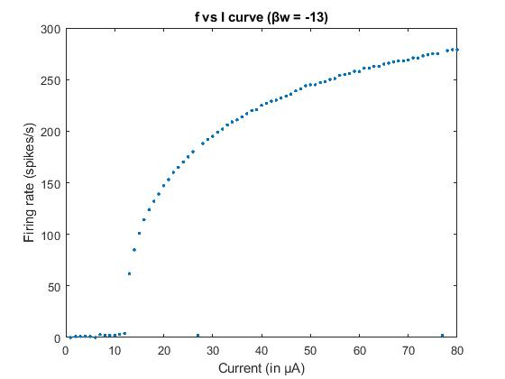
f-I Curves
Class I
Class II

Slide 12
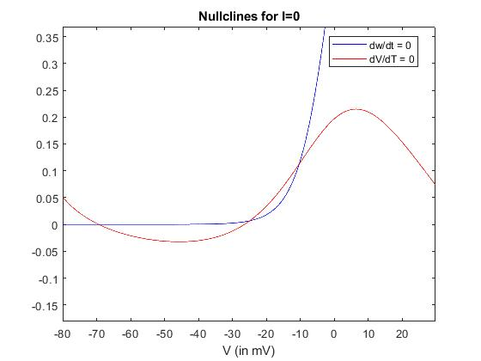
Class I

Slide 13
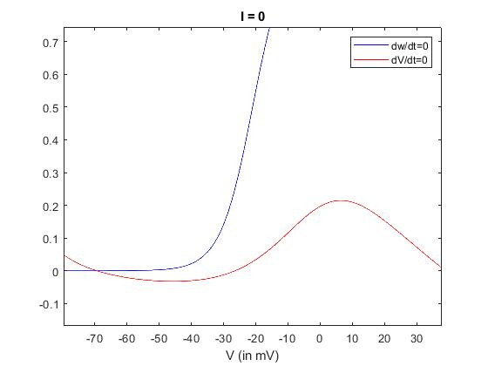
Class II and Class III

Slide 14
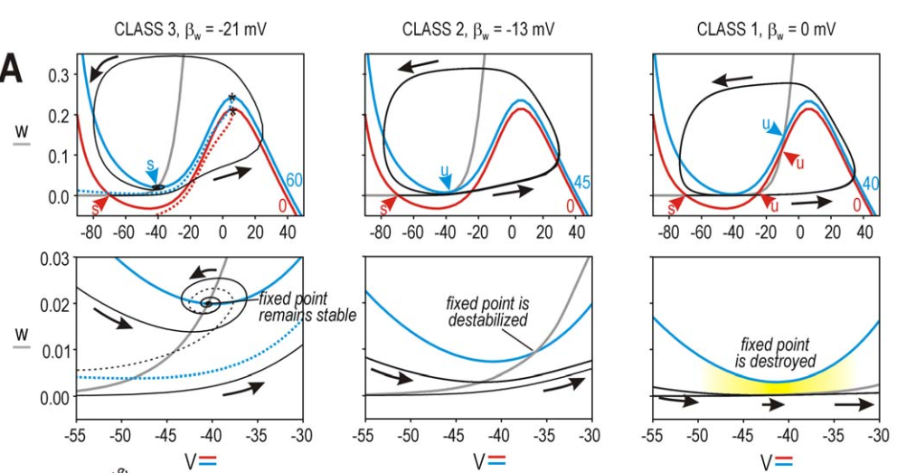
Phase plane analysis

Slide 15
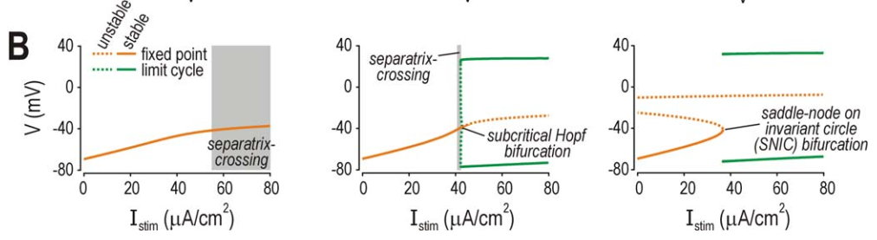
Bifurcations caused due to parameter β_{w}
Class I excitability
Class II excitability
Class III excitability

Slide 16
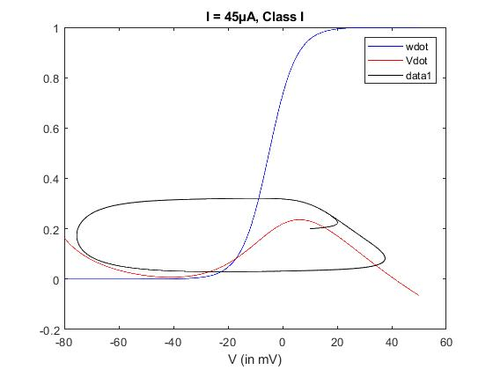
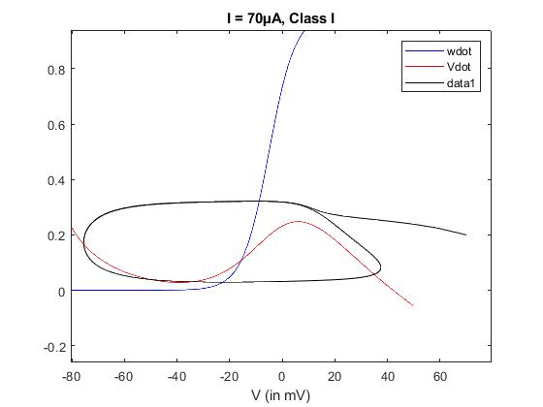
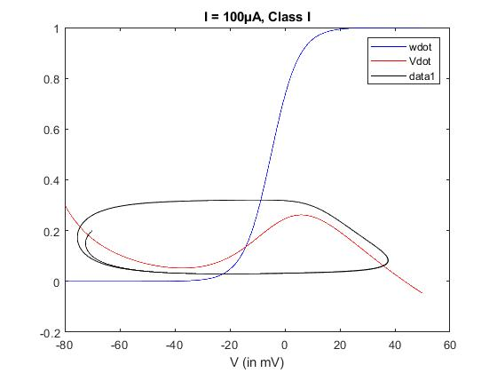
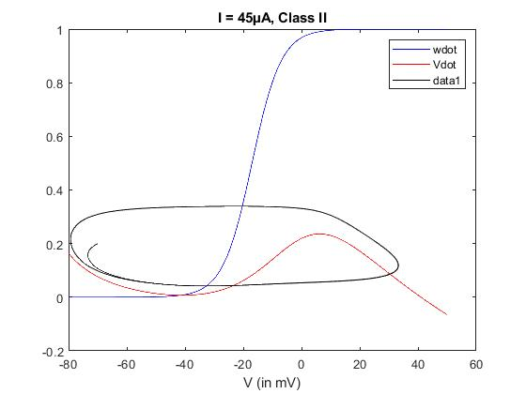
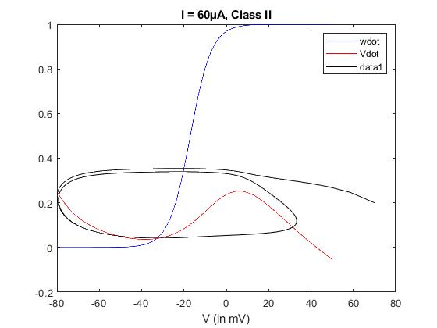
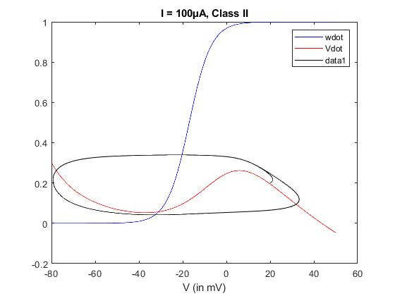
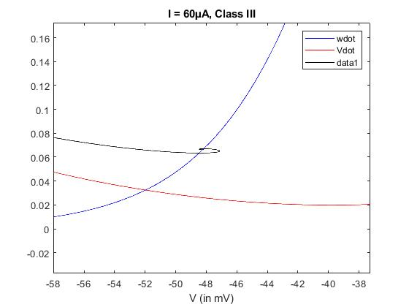
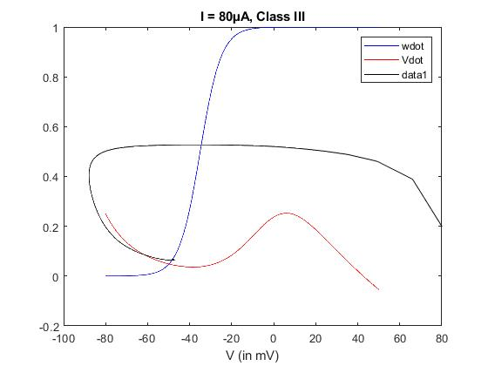
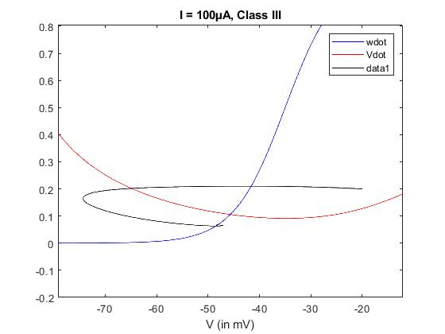
Phase portraits

Slide 17
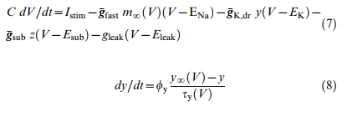
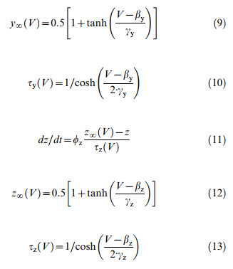
3D model
V’ = fast acting variable
y’ z’ = slow acting variable
V= membrane potential
yinf, zinf = open state probability functions
y, z = instantaneous open state probability
Tau = time scale for the recovery process

Slide 18
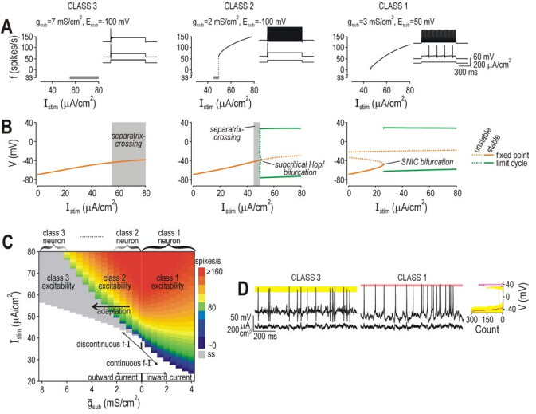

Slide 19
Thank you!
Special thanks : Anagh Pathak

